Slide 1
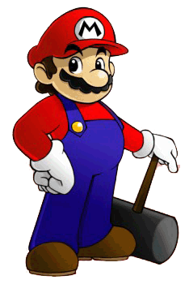
Hammer smash!
1
Notes:
1
<number>

Slide 2
2
Project Goal
Learning implementation of simple computer
graphics using C and also an easy-to-use graphics
library

Slide 3
3
Project features
Written in C language
Used in Borland Graphics Interface (BGI) Graphic library
CodeBlocks used as the compiler
Introduced in modular programming

Slide 4
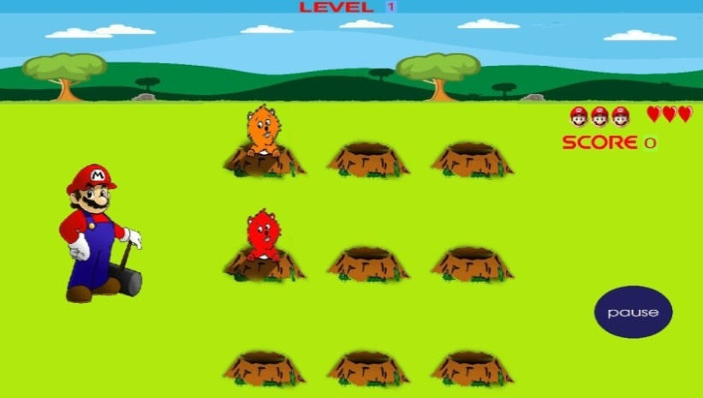
4
Hammer smash!
It is a simple arcade game
A game of a Hammer man and rabbits
Rabbits keek randomly from the hole 1 to 9

Slide 5
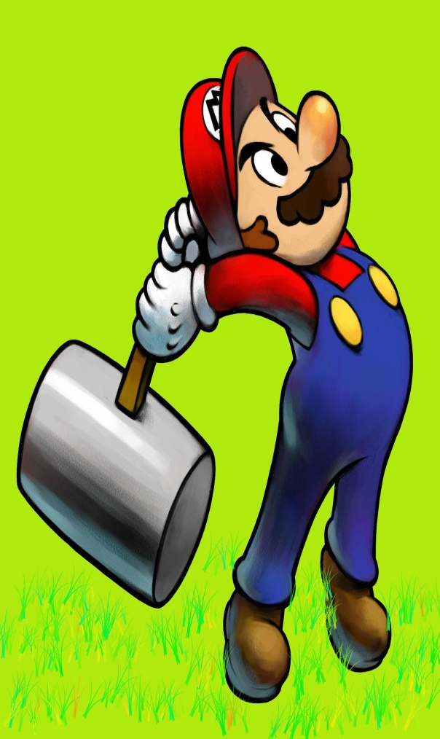
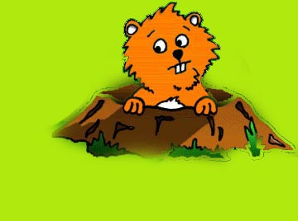
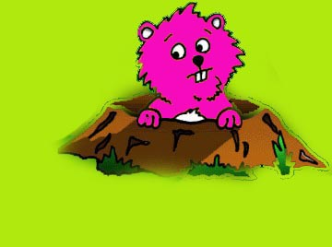
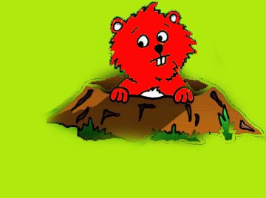
5
How to Play ?
Hit the rabbit
Get points
Get Bonus points
Level Up
Become the highscorer

Slide 6
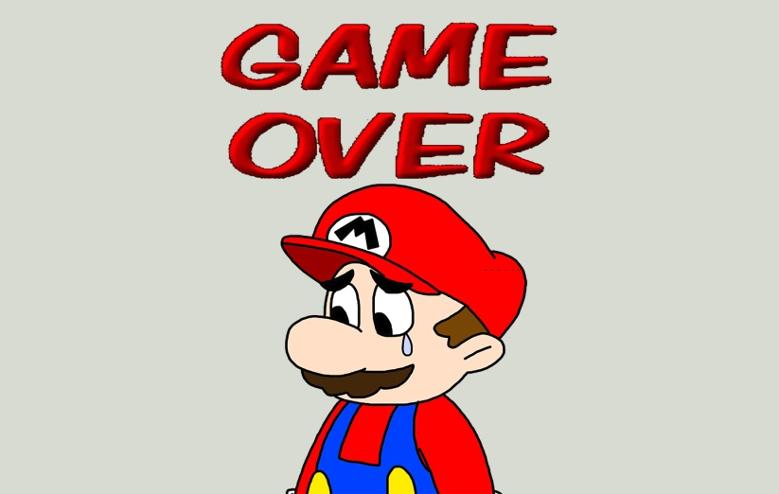
6
Gameover….
Miss hit ,lose chanches & life
Three miss chances or Don’t hit four times consecutively
spoil a life
After losing all three lives then game is over

Slide 7
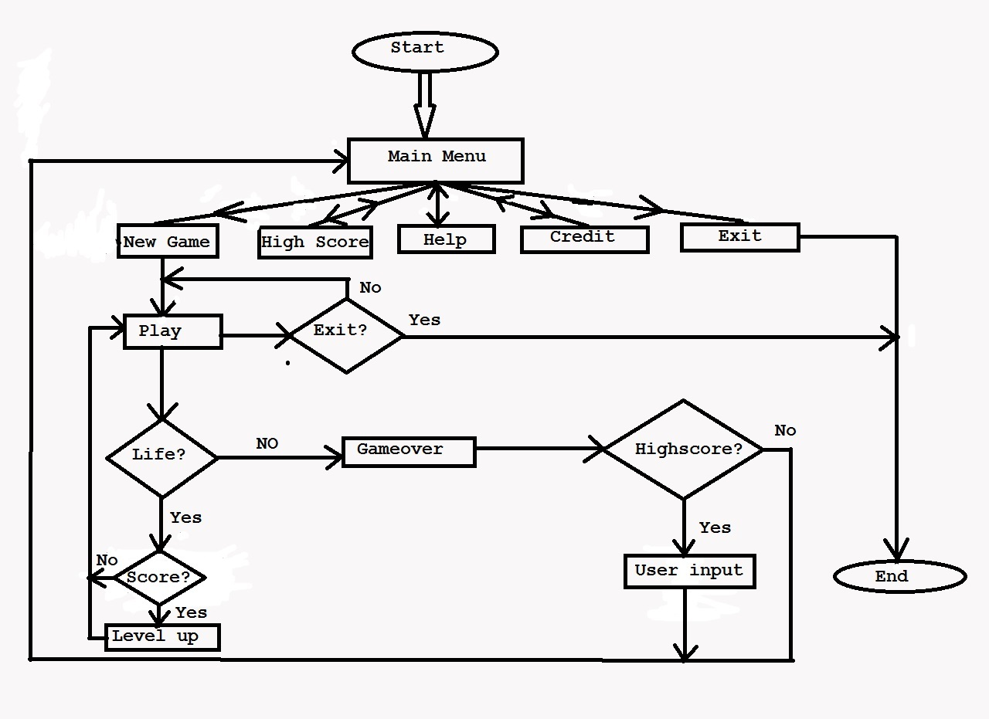
7
Game structure

Slide 8
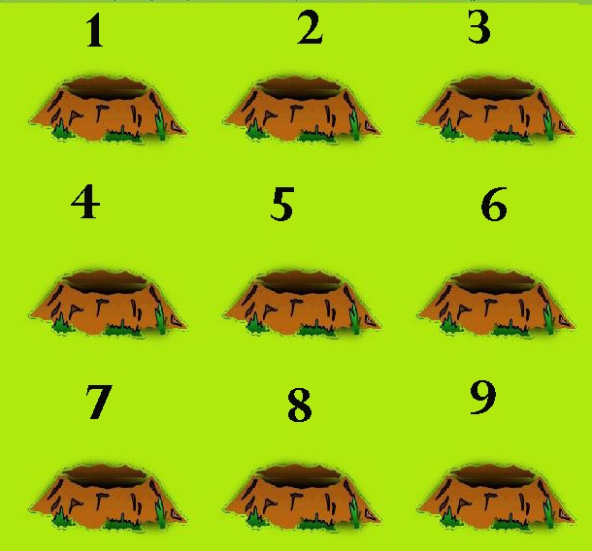
10
User friendly….
Smooth controlling of numeric keys to hit the rabbits

Slide 9
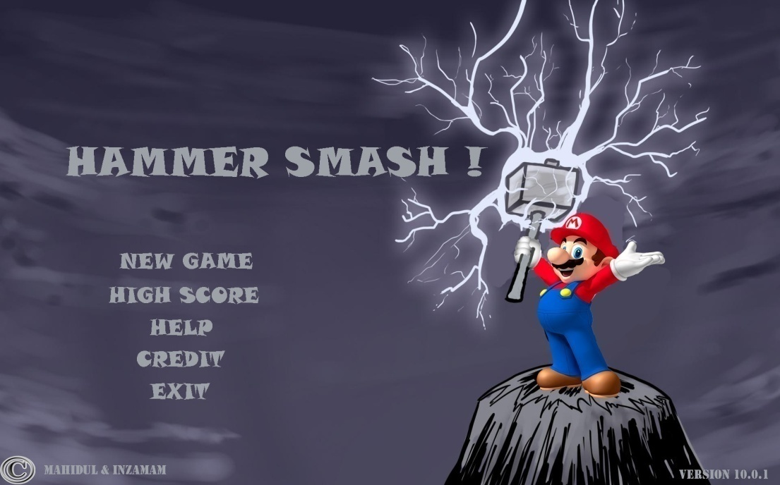
11
User friendly….
Main menu is fully mouse controlled

Slide 10
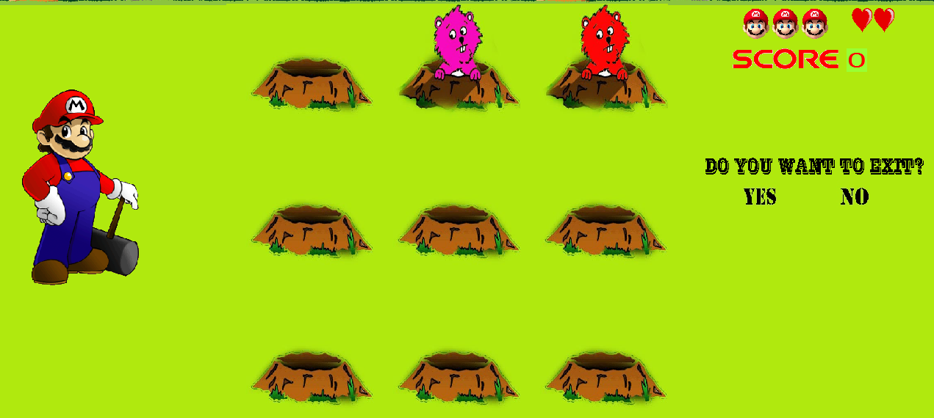
12
User friendly….
Exit the game using ESC key

Slide 11
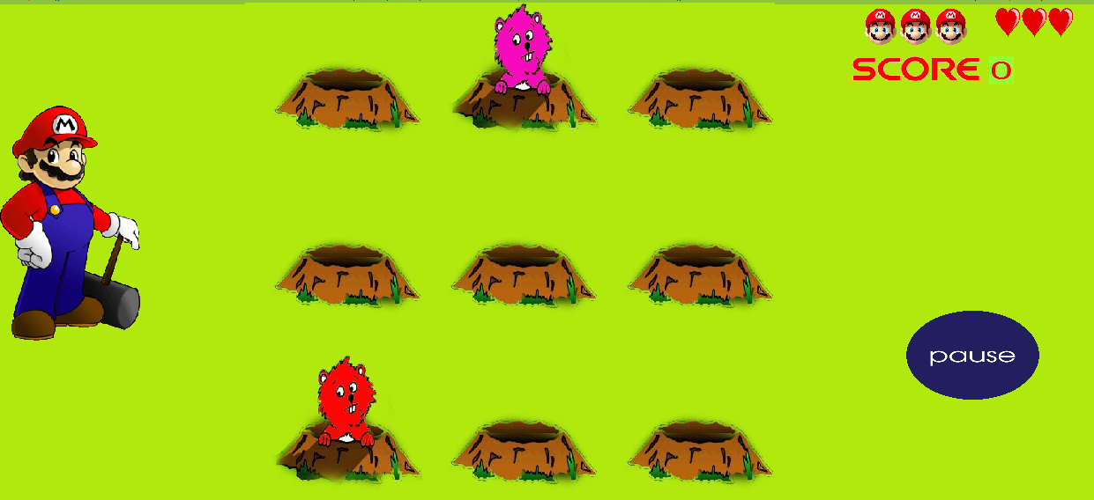
13
User friendly…..
Pause option using space bar

Slide 12
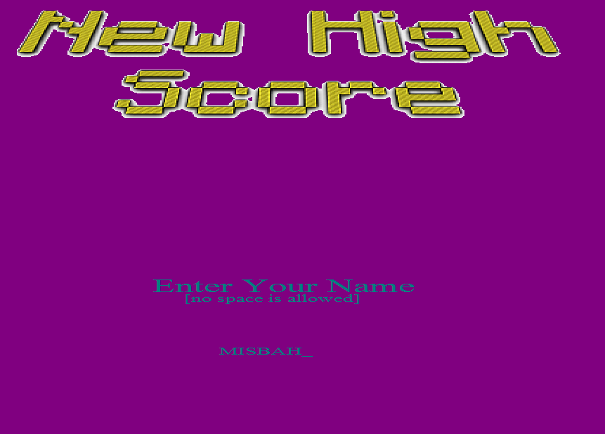
14
User friendly…..
Taking input from highscorer using enter and backspace key

Slide 13
15
Limitations…
Can’t accept two input simultaneusly.
Can’t run perfectly in low resulation monitor
No controller setting

Slide 14
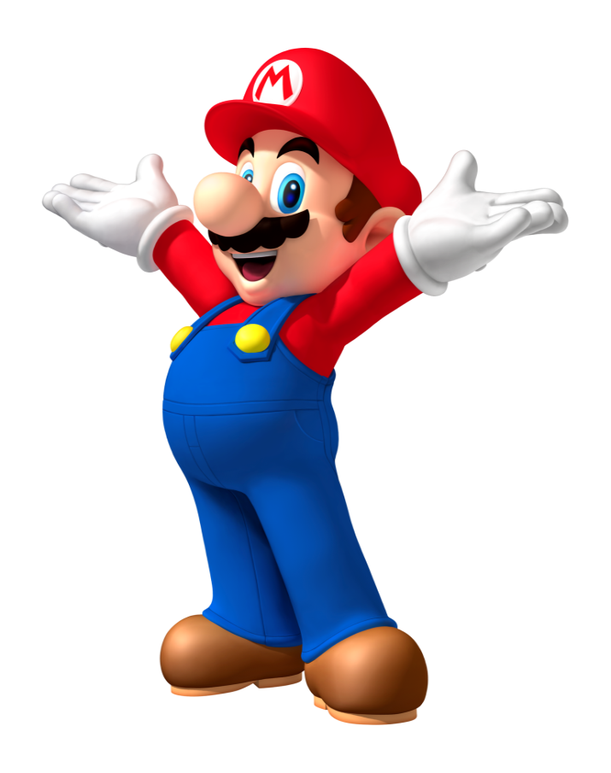
16
THANK YOU

